Slide 1
NLP

Slide 2
Introduction to NLP
Information Retrieval

Slide 3
Introduction
People search the Web daily
Search engines
Google
Bing
Baidu
Yandex
Information Retrieval is about search engines

Slide 4
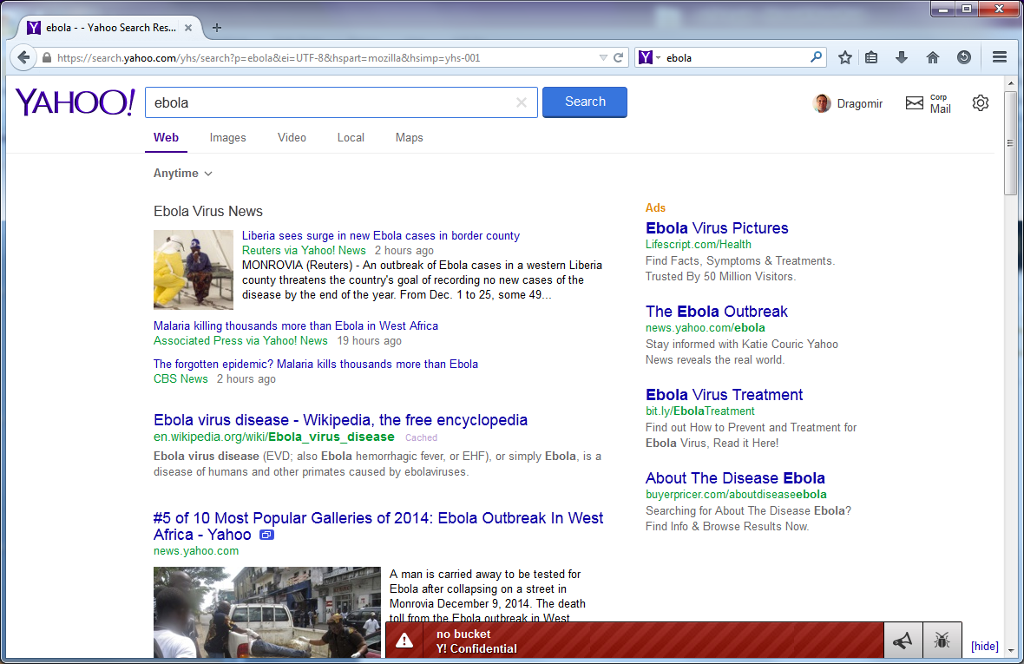
Yahoo Search

Slide 5

Amazon Search

Slide 6
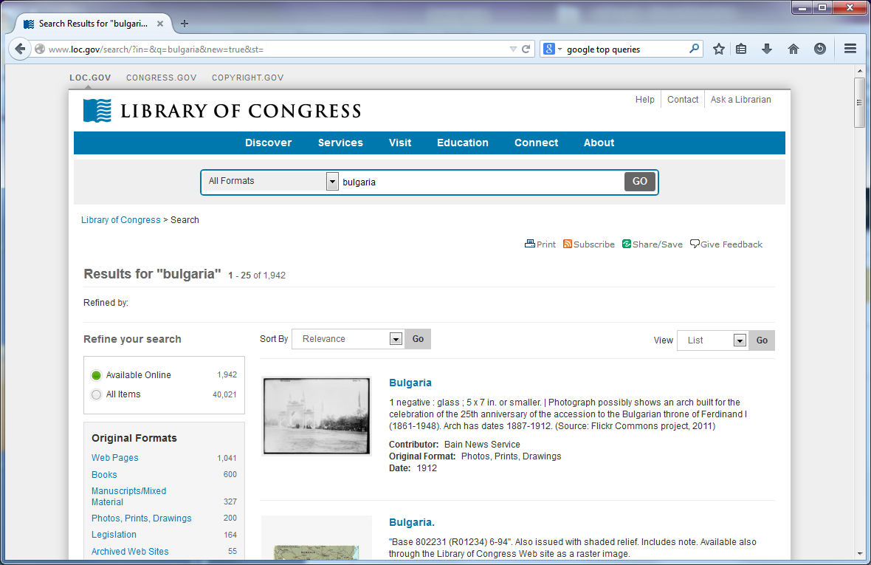
Library of Congress Search

Slide 7
Examples of Search Engines
Conventional (library catalog)
Search by keyword, title, author, etc.
Text-based (Lexis-Nexis, Google, Yahoo!)
Search by keywords. Limited search using queries in natural language.
Image-based
shapes, colors, keywords
Question answering systems (ask.com)
Search in (restricted) natural language
Clustering systems (Vivísimo, Clusty)
Research systems (Lemur, Nutch)

Slide 8
Sample Queries
How to get rid of stretch marks
Dodge
Kourtney Kardashian
How many calories are in pumpkn pie
Angelina Jolie and Brad Pitt
How to vote
Derek Jeter
Interstellar trailer
What is Ebola?
https://www.google.com/trends/topcharts

Slide 9
The size of the World Wide Web
The size of the indexed world wide web pages (by Nov 2015)
Indexed by Google: about 48 Billion pages
Indexed by Bing: about 25 Billion pages
http://www.worldwidewebsize.com/

Slide 10
Web Statistics
Twitter hits 400 million tweets per day
June, 2012. Dick Costolo, CEO at Twitter
Over 2.5 billion photos uploaded to Facebook each month (2010)
blog.facebook.com
Google’s clusters process a total of more than 20 petabytes of data per day.
2008. Jeffrey Dean from Google

Slide 11
Challenges
Dynamically generated content
New pages get added all the time
The size of the blogosphere doubles every 6 months

Slide 12
Characteristics of User Queries
Sessions
users revisit their queries
Very short queries
typically 2 words long
A large number of typos
A small number of popular queries
A long tail of infrequent ones
Almost no use of advanced query operators
with the exception of double quotes

Slide 13
Information Retrieval
Baseline Process
Given a collection of documents
And a user’s query
Find the most relevant documents

Slide 14
Key Terms Used in IR
Query
a representation of what the user is looking for - can be a list of words or a phrase.
Document
an information entity that the user wants to retrieve
Collection
a set of documents
Index
a representation of information that makes querying easier
Term
word or concept that appears in a document or a query

Slide 15
Documents
Not just printed paper
Can be records, pages, sites, images, people, movies
Document encoding (Unicode)
Document representation
Document preprocessing (e.g., removing metadata)
Words, terms, types, tokens

Slide 16
Introduction to NLP
Search Engine Architecture

Slide 17
Search Engine Architecture
Decide what to index
Collect it
Index it (efficiently)
Keep the index up to date
Provide user-friendly query facilities

Slide 18
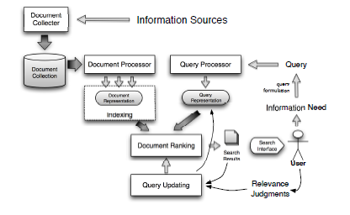
Search Engine Architecture

Slide 19
Document Representations
Term-document matrix (m x n)
Document-document matrix (n x n)
Typical example in a medium-sized collection
n=3,000,000 documents
m=50,000 terms
Typical example on the Web
n=30,000,000,000
m=1,000,000
Boolean vs. integer-valued matrices

Slide 20
Storage Issues
Example
Imagine a medium-sized collection with n=3,000,000 and m=50,000
How large a term-document matrix will be needed?
Is there any way to do better?
Any heuristic?

Slide 21
Inverted Index
Instead of an incidence vector, use a posting table
VERMONT: D1, D2, D6
CONNECTICUT: D1, D5, D6, D7
Use linked lists to be able to insert new document postings in order and to remove existing postings.
Can be used to compute document frequency
Keep everything sorted! This gives you a logarithmic improvement in access.

Slide 22
Basic operations
Conjunction (AND)
iterative merge of the two postings: O(x+y)
Disjunction (OR)
very similar
Negation (NOT)
can we still do it in O(x+y)?
Example: VERMONT AND NOT MASSACHUSETTS
Example: MASSACHUSETTS OR NOT VERMONT
Recursive operations
Optimization
start with the smallest sets

Slide 23
The Vector Model
Term 1
Doc 1
Doc 2
Term 3
Term 2
Doc 3

Slide 24
Queries as Documents
Advantages:
Mathematically easier to manage
Problems:
Different lengths
Syntactic differences
Repetitions of words (or lack thereof)

Slide 25
Vector queries
Each document is represented as a vector
Non-efficient representation
Dimensional compatibility

Slide 26
The matching process
Document space
Matching is done between a document and a query (or between two documents)
Distance vs. similarity measures.
Euclidean distance (define)
Manhattan distance (define)
Word overlap
Jaccard coefficient

Slide 27
Similarity Measures
The Cosine measure (normalized dot product)
|D ∩ Q|
Σ (d_{i} . q_{i})
σ (D,Q) = =
|D| . |Q|
Σ (d_{i})² .
Σ (q_{i})²
The Jaccard coefficient
|D ∩ Q|
σ (D,Q) =
|D ∪ Q|

Slide 28
Exercise
Compute the cosine scores
σ (D₁,D₂)
σ (D₁,D₃)
for the documents
D₁ = <1,3>
D₂ = <100,300>
D₃ = <3,1>
Compute the corresponding Euclidean distances, Manhattan distances, and Jaccard coefficients.

Slide 29
Phrase-based Queries
Examples
“New York City”
“Ann Arbor”
“Barack Obama”
We don’t want to match
York is a city in New Hampshire

Slide 30
Positional Indexing
Keep track of all words and their positions in the documents
To find a multi-word phrase, look for the matching words appearing next to each other

Slide 31
Document Ranking
Compute the similarity between the query and each of the documents
Use cosine similarity
Use TF*IDF weighting
Return the top K matches to the user

Slide 32
Evaluation
Different criteria
Size of index
Speed of indexing
Speed of retrieval
Accuracy
Timeliness
Ease of use
Expressiveness of search language

Slide 33
Contingency Table
retrieved
not retrieved
relevant
w=tp
x=fn
n₁ = w + x
not relevant
y=fp
z=tn
n₂ = w + y
N

Slide 34
Precision and Recall
w
Recall:
w+x
w
Precision:
w+y

Slide 35
Issues
Why not use accuracy A=(w+z)/N?
Average precision
Report when P=R
F measure:
F=(β²+1)PR/(β²P+R)
F1 measure:
F1 = 2/(1/R+1/P)
harmonic mean of P and R

Slide 36
[From Salton’s book]

Slide 38
Interpolated average precision (e.g., 11pt)
Interpolation – what is precision at recall=0.5?

Slide 39
Sample TREC query
<top>
<num> Number: 305
<title> Most Dangerous Vehicles
<desc> Description:
Which are the most crashworthy, and least crashworthy,
passenger vehicles?
<narr> Narrative:
A relevant document will contain information on the crashworthiness of a given vehicle or vehicles that can be used to draw a comparison with other vehicles. The document will have to describe/compare vehicles, not drivers. For instance, it should be expected that vehicles preferred by 16-25 year-olds would be involved in more crashes, because that age group is involved in more crashes. I would view number of fatalities per 100 crashes to be more revealing of a vehicle's crashworthiness than the number of crashes per 100,000 miles, for example.
</top>
LA031689-0177
FT922-1008
LA090190-0126
LA101190-0218
LA082690-0158
LA112590-0109
FT944-136
LA020590-0119
FT944-5300
LA052190-0048
LA051689-0139
FT944-9371
LA032390-0172
LA042790-0172 LA021790-0136 LA092289-0167 LA111189-0013 LA120189-0179 LA020490-0021 LA122989-0063 LA091389-0119 LA072189-0048 FT944-15615 LA091589-0101 LA021289-0208

Slide 40
<DOCNO> LA031689-0177 </DOCNO>
<DOCID> 31701 </DOCID>
<DATE><P>March 16, 1989, Thursday, Home Edition </P></DATE>
<SECTION><P>Business; Part 4; Page 1; Column 5; Financial Desk </P></SECTION>
<LENGTH><P>586 words </P></LENGTH>
<HEADLINE><P>AGENCY TO LAUNCH STUDY OF FORD BRONCO II AFTER HIGH RATE OF ROLL-OVER ACCIDENTS </P></HEADLINE>
<BYLINE><P>By LINDA WILLIAMS, Times Staff Writer </P></BYLINE>
<TEXT>
<P>The federal government's highway safety watchdog said Wednesday that the Ford Bronco II appears to be involved in more fatal roll-over
accidents than other vehicles in its class and that it will seek to determine if the vehicle itself contributes to the accidents. </P>
<P>The decision to do an engineering analysis of the Ford Motor Co. utility-sport vehicle grew out of a federal accident study of the
Suzuki Samurai, said Tim Hurd, a spokesman for the National Highway Traffic Safety Administration. NHTSA looked at Samurai accidents after
Consumer Reports magazine charged that the vehicle had basic design flaws. </P>
<P>Several Fatalities </P>
<P>However, the accident study showed that the "Ford Bronco II appears to have a higher number of single-vehicle, first event roll-overs,
particularly those involving fatalities," Hurd said. The engineering analysis of the Bronco, the second of three levels of investigation
conducted by NHTSA, will cover the 1984-1989 Bronco II models, the agency said. </P>
<P>According to a Fatal Accident Reporting System study included in the September report on the Samurai, 43 Bronco II single-vehicle
roll-overs caused fatalities, or 19 of every 100,000 vehicles. There were eight Samurai fatal roll-overs, or 6 per 100,000; 13 involving
the Chevrolet S10 Blazers or GMC Jimmy, or 6 per 100,000, and six fatal Jeep Cherokee roll-overs, for 2.5 per 100,000. After the
accident report, NHTSA declined to investigate the Samurai. </P>
...
</TEXT>
<GRAPHIC><P> Photo, The Ford Bronco II "appears to have a higher
number of single-vehicle, first event roll-overs," a federal official
said. </P></GRAPHIC>
<SUBJECT>
<P>TRAFFIC ACCIDENTS; FORD MOTOR CORP; NATIONAL HIGHWAY TRAFFIC SAFETY ADMINISTRATION; VEHICLE INSPECTIONS;
RECREATIONAL VEHICLES; SUZUKI MOTOR CO; AUTOMOBILE SAFETY </P>
</SUBJECT>
</DOC>

Slide 41
TREC (cont’d)
http://trec.nist.gov/tracks.html
http://trec.nist.gov/presentations/presentations.html

Slide 42
Classic Reference Collections
Generic retrieval
OHSUMED, CRANFIELD, CACM
Text classification
Reuters, 20newsgroups
Question answering
TREC-QA
Web
DOTGOV, wt100g
Blogs
Buzzmetrics datasets
TREC ad hoc collections, 2-6 GB
TREC Web collections, 2-100GB

Slide 43
Comparing two systems
Comparing A and B
One query?
Average performance?
Need: A to consistently outperform B
[Example from James Allan]

Slide 44
The Sign Test
Example 1:
A > B (12 times)
A = B (25 times)
A < B (3 times)
p < 0.035 (significant at the 5% level)
Example 2:
A > B (18 times)
A < B (9 times)
p < 0.122 (not significant at the 5% level)
External link:
http://www.fon.hum.uva.nl/Service/Statistics/Sign_Test.html

Slide 45
Other Tests
Student t-test
takes into account the actual performances, not just which system is better
http://www.fon.hum.uva.nl/Service/Statistics/Student_t_Test.html
http://www.socialresearchmethods.net/kb/stat_t.php
Wilcoxon Matched-Pairs Signed-Ranks Test
http://www.fon.hum.uva.nl/Service/Statistics/Signed_Rank_Test.html

Slide 46
Kappa – interannotator agreement
N: number of items (index i)
n: number of categories (index j)
k: number of annotators

Slide 47
Kappa example
 | J1+ | J1- | TOTAL
J2+ | 300 | 10 | 310
J2- | 20 | 70 | 90
TOTAL | 320 | 80 | 400

Slide 48
Kappa (cont’d)
P(A) = 370/400 = 0.925
P (-) = (10+20+70+70)/800 = 0.2125
P (+) = (10+20+300+300)/800 = 0.7875
P (E) = 0.2125 * 0.2125 + 0.7875 * 0.7875 = 0.665
K = (0.925-0.665)/(1-0.665) = 0.776
Kappa higher than 0.67 is tentatively acceptable; higher than 0.8 is good

Slide 49
Exercise
Go to http://www.google.com and search for documents on Tolkien’s “Lord of the Rings”.
Note! Before starting the exercise, have a clear idea of what a relevant document for your query should look like. Try different information needs.
Try different ways of phrasing the query: e.g., Tolkien, “JRR Tolkien”, +“JRR Tolkien” +“Lord of the Rings”, etc. For each query, compute the precision (P) based on the first 10 documents returned by Google.
Later, try different queries.

Slide 50
Lemur/Indri
An IR toolkit emphasizing language models
Developed at CMU and Univ. of Massachusetts in 2000’s
Written in C++, highly extensible
Vector space and probabilistic models including language models
Achieving good TREC performance with a simple language model

Slide 51
Lucene
Open Source IR toolkit
Initially developed by Doug Cutting in Java
Now has been ported to some other languages
Good for building IR/Web applications
Many applications have been built using Lucene (e.g., Nutch and SOLR)

Slide 52
Information Retrieval
Query Modification and Relevance Feedback

Slide 53
Query Modification
Also known as query reformulation, query substitution …
Problem: initial query may not be the most appropriate to satisfy a given information need
Idea: modify the original query so that it gets closer to the right documents in the vector space

Slide 54
Types of Query Modification
Morphological:
Spelling check
Semantic:
Query expansion
Query substitution
Query suggestion

Slide 55
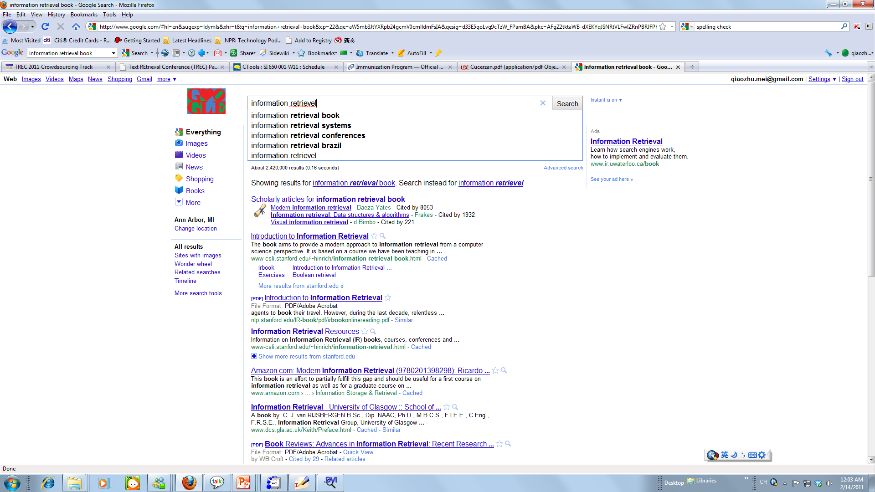
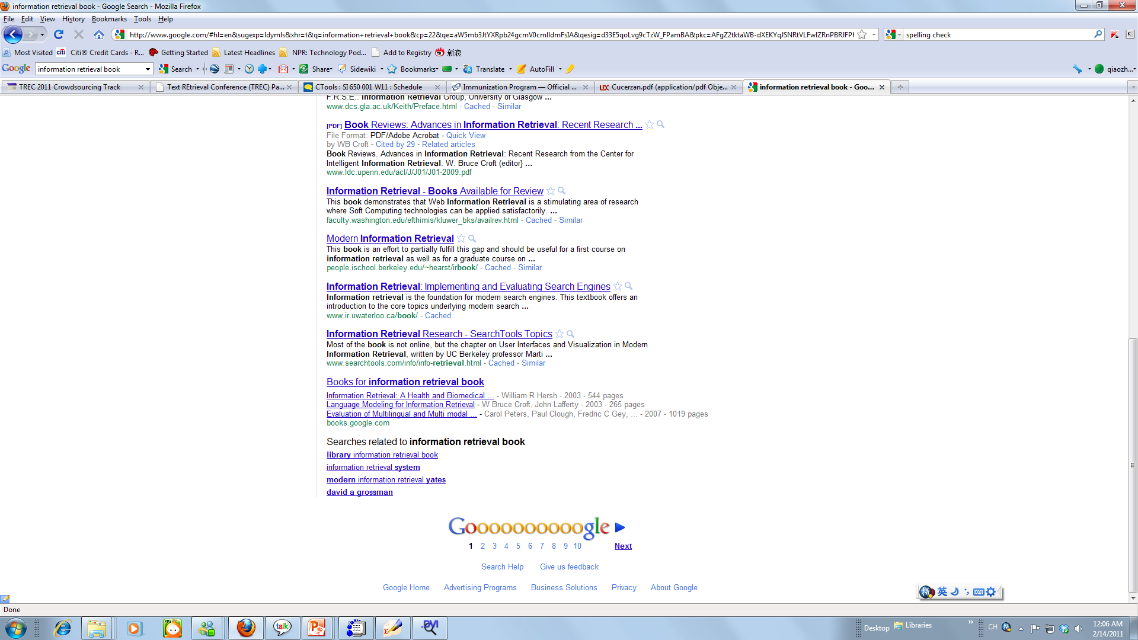
Original Query
Query Expansion
Query substitution
Spelling error correction
Query suggestion

Slide 56
Spelling Error Correction
Roughly 10-15% of the queries sent to search engines contain errors. (Cucerzan and Brill 2004)
Traditional techniques rely on dictionary match, combined with
Common keyboard mistakes
Phonetic mistakes
Context mistakes
Cognitive mistakes
Modern techniques rely on query log analysis + string similarity

Slide 57
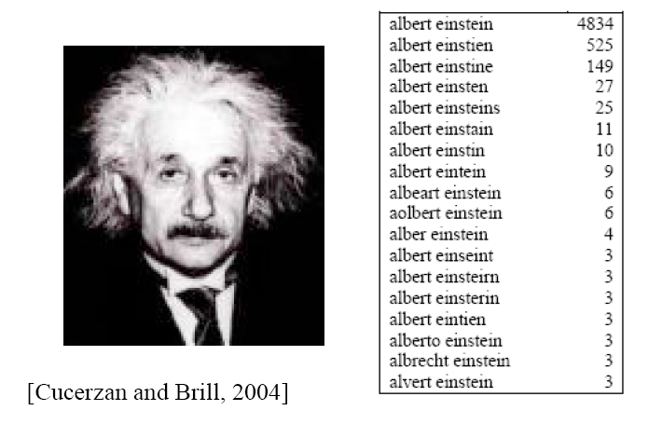
Query Reformulation – Spelling Correction

Slide 58
Query Recommendation/Suggestion
Recommend alternative queries to the user. Alternative queries could be totally different from the original query.
Usually done with query log analysis

Slide 59
Query Expansion
Refining the information need of search by adding new terms to query
Sometimes also remove terms …
Traditional methods:
Thesaurus-based expansion
Ontology based expansion
Hyponyms and hypernyms
Corpus-based methods
Mining related terms from large scale corpus
Feedback: most effective method in IR
Query log based methods (later)

Slide 60
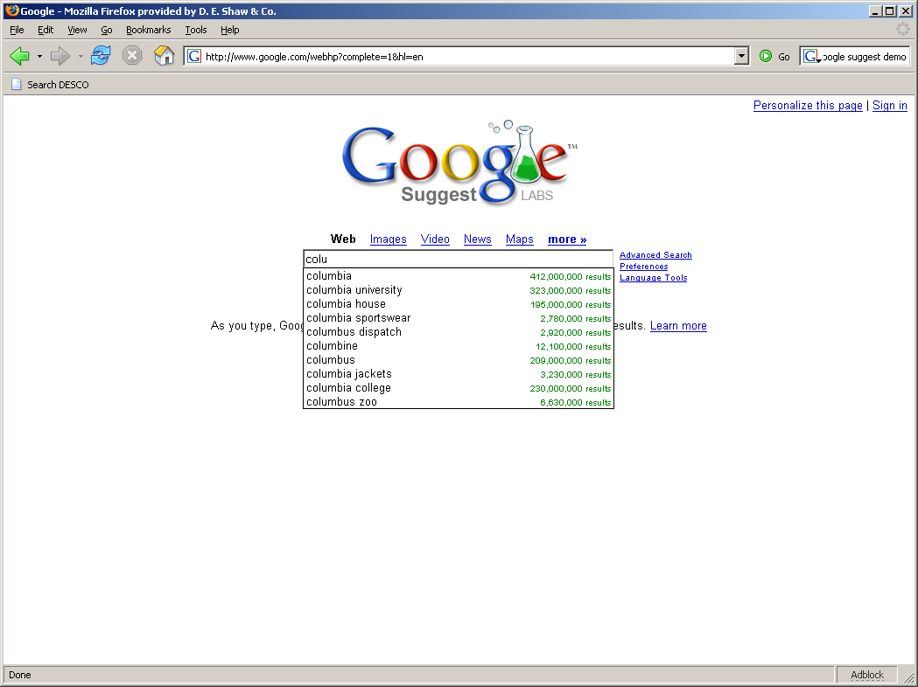
Query Expansion

Slide 61
Query Expansion
Corpus-based: mine query logs
NLP-based
Vector-space relevance feedback

Slide 62
Relevance Feedback
Problem: initial query may not be the most appropriate to satisfy a given information need.
Idea: modify the original query so that it gets closer to the right documents in the vector space

Slide 63
Intuition in Feedback
Query expansion: feedback can help discover related query terms
Query = “information retrieval”
Relevant or pseudo-relevant docs may would likely share words related to “information retrieval”, e.g., “search engine”, “search”, “user”, “query”, etc.
These words generally have higher frequency in these relevant or pseudo-relevant documents than in the whole collection
They can be used to expand the original query to increase recall and sometimes also precision

Slide 64
A Machine Learning Interpretation
Machine learning/pattern recognition
Query = a special labeled example
Relevant documents = labeled examples (supervised learning)
Pseudo-relevant documents = unlabeled examples (semi-supervised learning)

Slide 65
Overview of Feedback Techniques
Feedback as machine learning: many possibilities
Standard ML: Given examples of relevant (and non-relevant) documents, learn how to classify a new document as either “relevant” or “non-relevant”.
“Modified” ML: Given a query and examples of relevant (and non-relevant) documents, learn how to rank new documents based on relevance
Challenges:
Sparse data
Censored sample
How to deal with query?
Modeling noise in pseudo feedback (as semi-supervised learning)

Slide 66
Overview of Feedback Techniques (Cont.)
Feedback as query expansion: traditional IR
Step 1: Term selection
Step 2: Query expansion
Step 3: Query term re-weighting
Traditional IR is still robust (Rocchio), but ML approaches can potentially be more accurate

Slide 67
Relevance Feedback in the Vector Space Model
Basic setting: Learn from examples
Positive examples: docs known to be relevant
Negative examples: docs known to be non-relevant
How do you learn from this to improve performance?
General method: Query modification
Adding new (weighted) terms
Adjusting weights of old terms
Doing both
The most well-known and effective approach is Rocchio [Rocchio 1971]

Slide 68
Rocchio Feedback: Illustration
-
-
-
-
-
-
+
+
+
-
-
+
+
-
-
-
-
+
q
q
-
-
+
+
+
-
-
+
+
-
-
+
+
+
+
+
-
+
+
+
-
-
-
-
-
-
-
-

Slide 69
Rocchio Feedback: Intuition
Query is represented as a vector (VSM)
Query can be updated by adding document vectors to query vectors
If a document is labeled as relevant – add it to the query vector
If a document is labeled as irrelevant – subtract it from the query vector
Weighting needed.

Slide 70
Rocchio Feedback: Formula
Parameters
New query vector
Original query vector
Relevant docs
Non-rel docs

Slide 71
Relevance Feedback
Automatic
Manual
Method: identifying feedback terms
Q’ = a₁Q + a₂R - a₃N
Often a₁ = 1, a₂ = 1/|R| and a₃ = 1/|N|

Slide 72
Example
Q = “safety minivans”
D₁ = “car safety minivans tests injury statistics” - relevant
D₂ = “liability tests safety” - relevant
D₃ = “car passengers injury reviews” - non-relevant
R = ?
N = ?
Q’ = ?

Slide 73
Pseudo Relevance Feedback
Automatic query expansion
Thesaurus-based expansion (e.g., using latent semantic indexing – later…)
Distributional similarity
Query log mining

Slide 74
Examples
Lexical semantics (Hypernymy):
Book: publication, product, fact, dramatic composition, record
Computer: machine, expert, calculator, reckoner, figurer
Fruit: reproductive structure, consequence, product
Politician: leader, schemer
Newspaper: press, publisher, product, paper, newsprint
Distributional clustering:
Book: autobiography, essay, biography, memoirs, novels
Computer: adobe, computing, computers, developed, hardware
Fruit: leafy, canned, fruits, flowers, grapes
Politician: activist, campaigner, politicians, intellectuals, journalist
Newspaper: daily, globe, newspapers, newsday, paper

Slide 75
Examples (query logs)
Book: booksellers bookmark blue
Computer: sales notebook stores shop
Fruit: recipes cake salad basket company
Games: online play gameboy free video
Politician: careers federal office history
Newspaper: online website college information
Schools: elementary high ranked yearbook
California: berkeley san francisco southern
French: embassy dictionary learn

Slide 76
Document Ranking
Compute the similarity between the query and each of the documents
Use cosine similarity
Use TF*IDF weighting
Return the top K matches to the user

Slide 77
The Basic Question of Ranking
Given a query, how do we know if document A is more relevant than B?
One Possible Answer:
If document A uses more query words than document B
(Word usage in document A is more similar to that in query)

Slide 78
Document Ranking
True R(q)
-
-
Retrieval function
f(d,q)=?
0.98 d₁ +
0.95 d₂ +
0.83 d₃ -
0.80 d₄ +
0.76 d₅ -
0.56 d₆ -
0.34 d₇ -
0.21 d₈ +
0.21 d₉ -
+
+
-
+
-
+
-
+
-
R’(q)
-
-
-
-
-
-
-
-
-
-
Measures the degree of relevance

Slide 79
Relevance = Similarity
Assumptions
Query and document are represented in a similar way
A query can be regarded as a “document”
Relevance(d, q) ∝ similarity(d, q)
R’(q) = {d∈C | f(d,q)>θ}, f(q,d)=Δ(Rep(q), Rep(d))
Key issues
How to represent a query/document?
How to define the similarity measure Δ?

Slide 80
Revisit: Vector Space Model
Represent a doc/query by a term vector
Term: basic concept, e.g., word or phrase
Each term defines one dimension
N terms define a high-dimensional space
Element of vector corresponds to term weight
E.g., d=(x₁,…,x_{N}), x_{i} is “importance” of term i
Measure relevance by the similarity/distance (e.g., the cosine similarity) between the query vector and document vector in the vector space

Slide 81
VS Model: illustration
Starbucks
? ?
D₂
D₉
? ?
D₁₁
D₃
D₅
D₁₀
D₄
D₆
Java
Query
D₇
D₈
D₁
Microsoft
? ?

Slide 82
What the VS model doesn’t say
How to define/select the “basic concept”
Concepts are assumed to be orthogonal
We talked about how to select index terms
How to assign weights
Weight in query indicates importance of term
Weight in doc indicates how well the term characterizes the document
We talked about simple presence/absence
How to define the similarity/distance measure

Slide 83
What’s a good “basic concept”?
Orthogonal
Linearly independent basis vectors
“Non-overlapping” in meaning
No ambiguity
Weights can be assigned automatically and hopefully accurately
Many possibilities: Words, stemmed words, phrases, “latent concept”, …

Slide 84
Why Is Being “Orthogonal” Important?
Query = {laptop computer pc sale}
Document 1 = {computer sale}
Document 2 = {laptop computer pc}

Slide 85
Ambiguity Is the Killer…
Query = {Jaguar band}
Document 1 = {Jaguar car}
Document 2 = {Jaguar cat}

Slide 86
How to Assign Weights?
Very, very important!
Why weighting
Query side: Not all terms are equally important
Doc side: Some terms carry more information about contents
How?
Two basic heuristics
TF (Term Frequency) = Within-doc-frequency
IDF (Inverse Document Frequency)
TF normalization

Slide 87
Weighting Is Very Important…
Query = {text information management}
Document 1 = {text information}
Document 2 = {information management}
Document 3 = {text management}

Slide 88
What’s a Reasonable Term Weight?
How do we weight the multiple occurrences of a term in a document?
How do we weight different terms differently?

Slide 89
What’s a Reasonable Term Weight?
How do we weight the multiple occurrences of a term in a document?
By Term Frequency (TF)
How do we weight different terms differently?

Slide 90
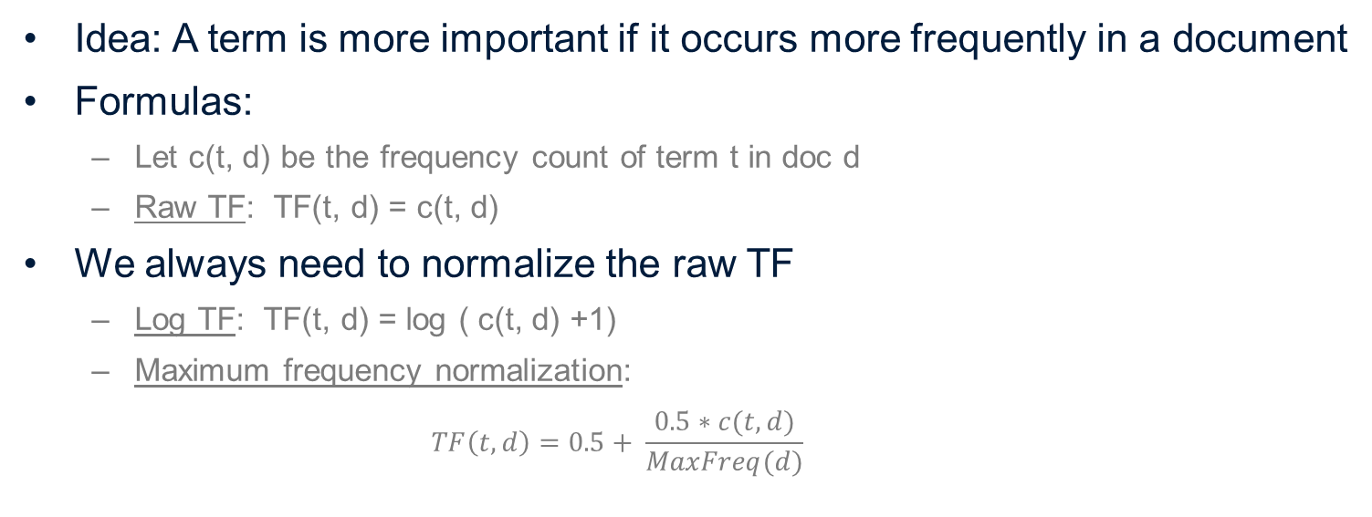
Term Frequency (TF) Weighting
Idea: A term is more important if it occurs more frequently in a document
Formulas:
Let c(t, d) be the frequency count of term t in doc d
Raw TF: TF(t, d) = c(t, d)
We always need to normalize the raw TF
Log TF: TF(t, d) = log ( c(t, d) +1)
Maximum frequency normalization:
$$TF\left(t, d\right)=0.5+ \frac{0.5∗c(t, d)}{MaxFreq(d)}$$

Slide 91
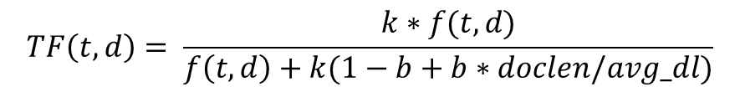
TF Normalization
TF Normalization can be even more complicated:
TF in Okapi/BM25:
Where doclen is the length of d and avg_dl is the average length of documents in the collection
Question: why do we need to normalize TF?
$$TF\left(t, d\right)= \frac{k∗f(t, d)}{f\left(t, d\right)+k(1−b+b∗doclen/avg_dl)}$$

Slide 92
TF Normalization
Why?
Document length variation
“Repeated occurrences” are less informative than the “first occurrence”
Two views of document length
A doc is long because it uses more words
A doc is long because it has more contents
Generally we want to penalize long documents, but avoid over-penalizing (pivoted normalization)

Slide 93
What’s a Reasonable Term Weight?
How do we weight the multiple occurrences of a term in a document?
By Term Frequency (TF)
How do we weight different terms differently?
By Inverted Document Frequency (IDF)

Slide 94
A Formulation of IDF
N: number of documents d_{k}: number of documents containing term k f_{ik}: absolute frequency of term k in document i w_{ik}: weight of term k in document i
idf_{k} = log₂(N/d_{k}) + 1 = log₂N - log₂d_{k} + 1

Slide 95
TF-IDF Weighting
TF-IDF weighting:
weight(t, d)=TF(t, d)*IDF(t)
Term is common in doc → high tf → high weight
Term is rare in collection→ high idf→ high weight
Imagine a word count profile, what kind of terms would have high weights?
How is this related to Luhn’s study of term frequency and Zipf’s law?

Slide 96
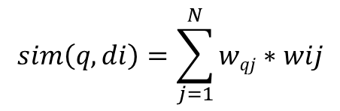
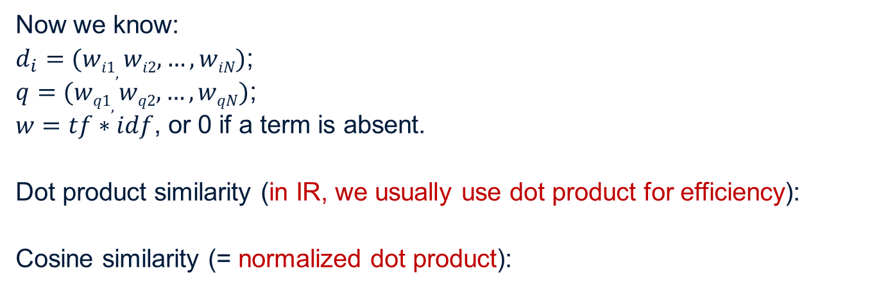
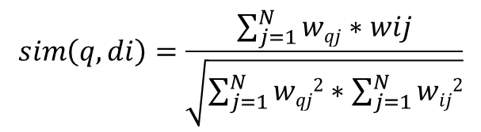
How to Measure Similarity?
$$sim\left(q, di\right)=\sum_{j=1}^{N}{wqj∗wij}$$
Now we know:
$d_{i}=(wi1,wi2, …,wiN)$;
$q=(wq1, wq2, …,wqN)$;
$w=tf∗idf$, or 0 if a term is absent.
Dot product similarity (in IR, we usually use dot product for efficiency):
Cosine similarity (= normalized dot product):
$$sim\left(q, di\right)=\frac{\sum_{j=1}^{N}{wqj∗wij}}{\sqrt{\sum_{j=1}^{N}{wqj2}∗\sum_{j=1}^{N}{wij2}}}$$

Slide 97
“Extensions” of Vector Space Model
Alternative similarity measures
Many other choices (tend not to be very effective)
P-norm (Extended Boolean): matching a Boolean query with a TF-IDF document vector
Alternative representation
Many choices (performance varies a lot)
Latent Semantic Indexing (LSI) [TREC performance tends to be average]
Generalized vector space model
Theoretically interesting, not seriously evaluated

Slide 98
Advantages of VS Model
Empirically effective! (Top TREC performance)
Intuitive
Easy to implement
Well-studied/Most evaluated
The Smart system
Developed at Cornell: 1960-1999
Still widely used
Warning: Many variants of TF-IDF!

Slide 99
Disadvantages of VS Model
Assume term independence
Which is never true!
Assume query and document to be the same
Lack of “predictive adequacy”
Arbitrary term weighting
Arbitrary similarity measure
Very sensitive to the selection of weighting.
Lots of parameter tuning!

Slide 100
NLP

